Slide 1

CS302 Design and Analysis of Algorithms
Muhammad sohail afzal

Slide 2
Graph Traversal
Two techniques of graph traversing for both directed or undirected graphs:
Breadth First Search (BFS) – Uses Queue
Depth First Search (DFS) – Uses Stack

Slide 3
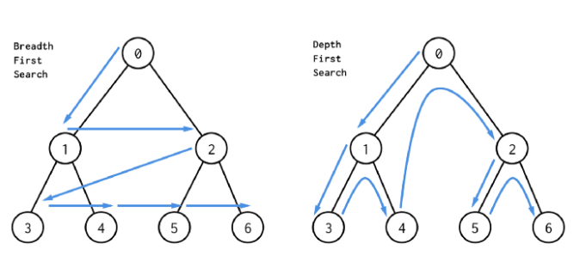
Graph Traversal

Slide 4
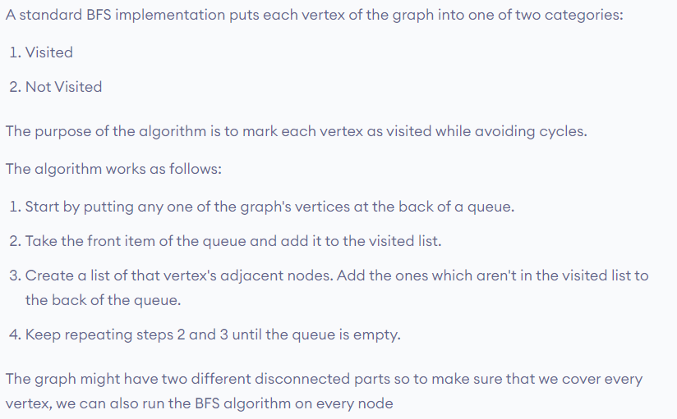
Graph Traversal : BFS
Visit starting vertex and then visit its neighbors and then neighbors of neighbors and so on

Slide 5
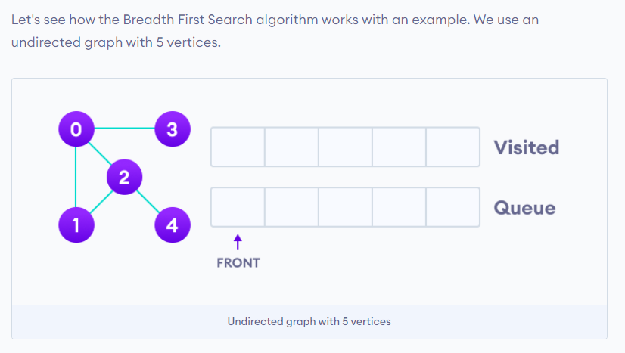
Graph Traversal : BFS

Slide 6
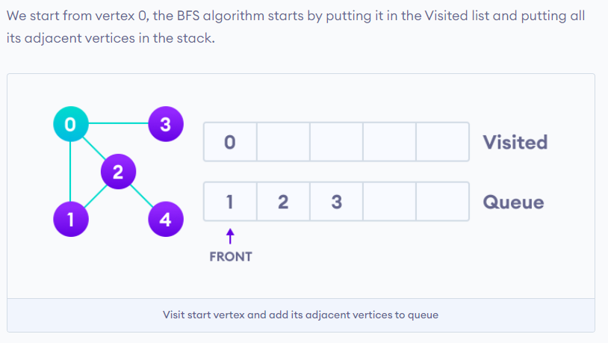
Graph Traversal : BFS

Slide 7
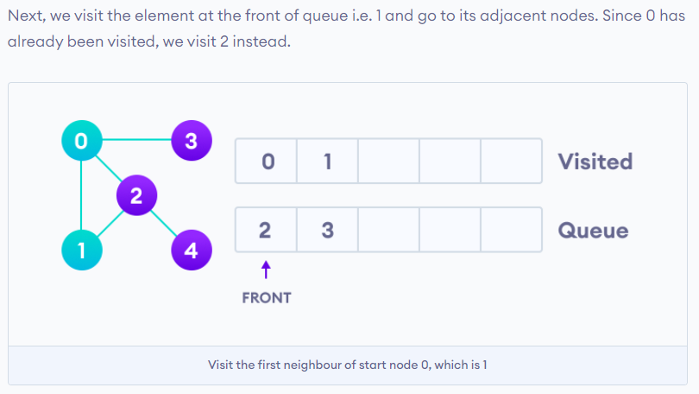
Graph Traversal : BFS

Slide 8
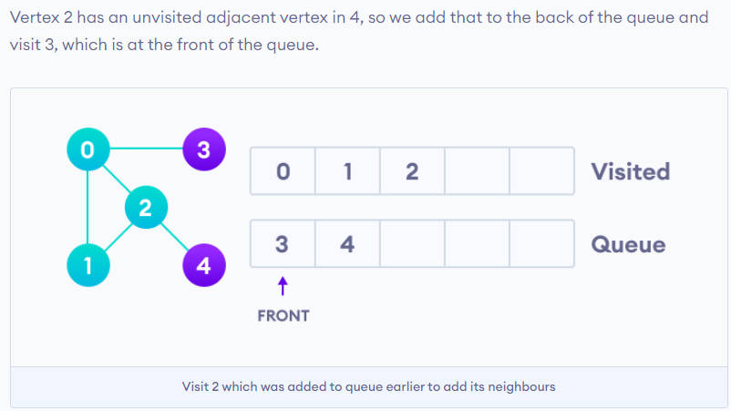
Graph Traversal : BFS

Slide 9
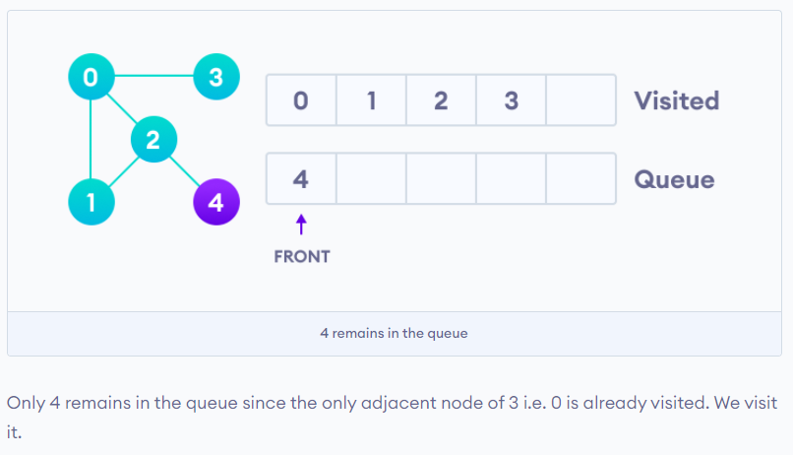
Graph Traversal : BFS

Slide 10
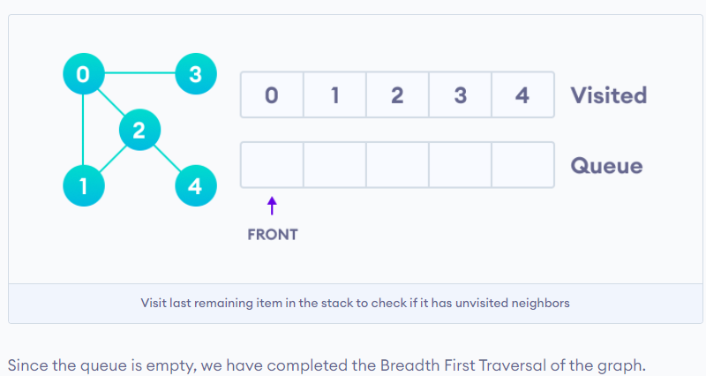
Graph Traversal : BFS

Slide 11
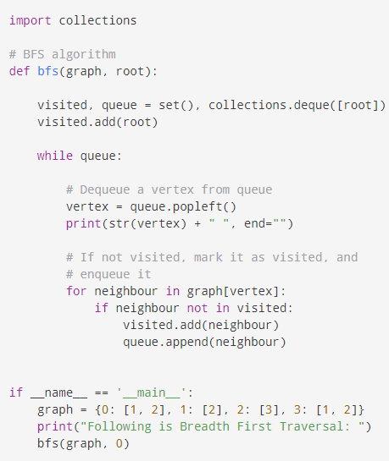
Graph Traversal : BFS
Time complexity = O(V+E)

Slide 12
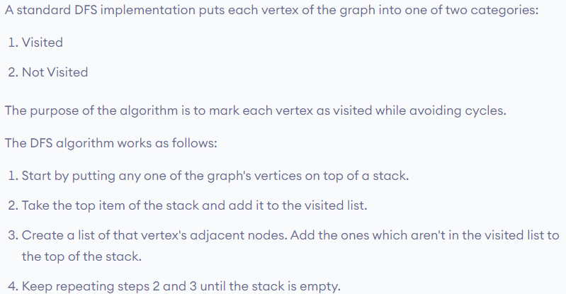
Graph Traversal : DFS
DFS traversal takes any path from starting vertex and goes into its depth. Then it back tracks and traverse any other path and goes in the depth of that too. And this goes on..

Slide 13
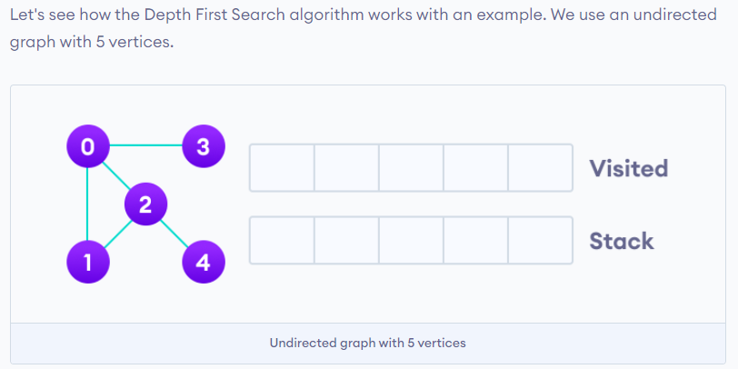
Graph Traversal : DFS

Slide 14
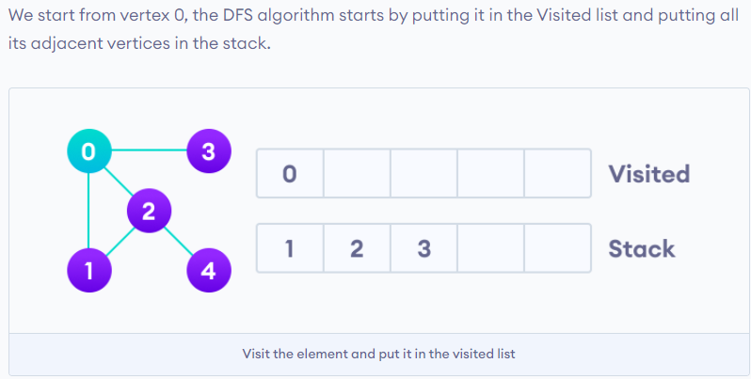
Graph Traversal : DFS

Slide 15
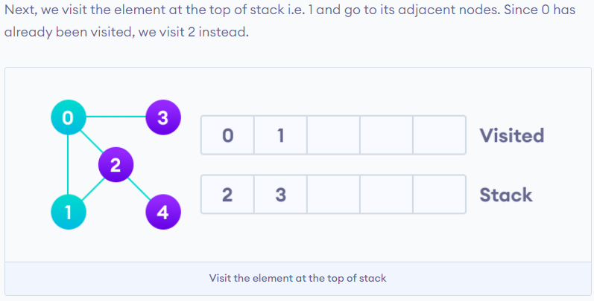
Graph Traversal : DFS

Slide 16
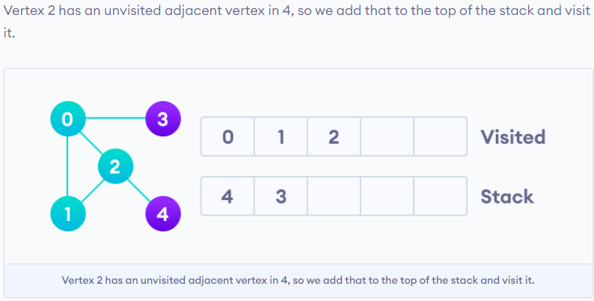
Graph Traversal : DFS

Slide 17
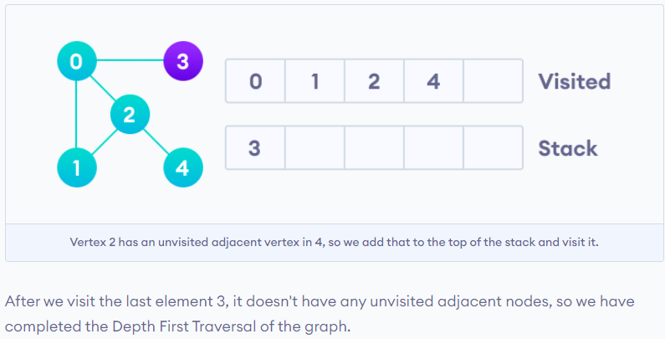
Graph Traversal : DFS

Slide 18
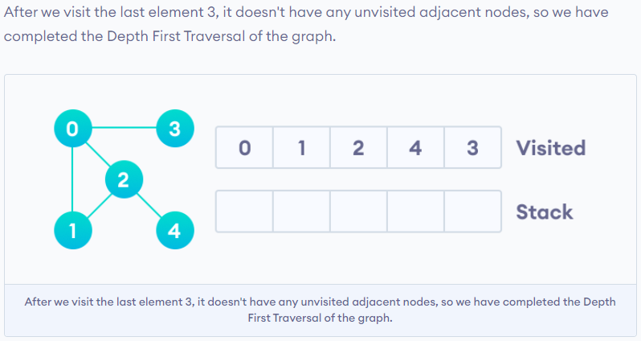
Graph Traversal : DFS

Slide 19
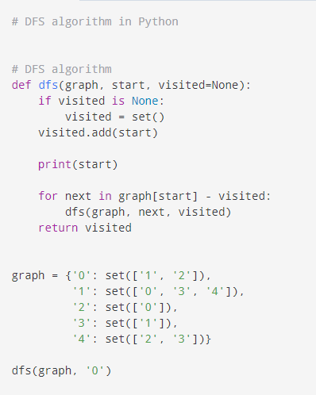
Graph Traversal : DFS
Time complexity = O(V+E)

Slide 20
Graph Traversal : Time complexity and Applications
Time complexity of BFS and DFS is O(V+E) because all vertices and edges will be visited
Applications of BFS & DFS:
For finding path from one vertex to every other
For detecting cycles
For GPS navigation
and etc

Slide 21
Graph Traversal : Applications
When to use DFS over BFS or BFS over DFS :
If you know a solution is not far from the root of the tree, a breadth first search (BFS) might be better.
If the tree is very deep and solutions are rare, depth first search (DFS) might take an extremely long time, but BFS could be faster.
If the tree is very wide, a BFS might need too much memory, so it might be completely impractical.
If solutions are frequent but located deep in the tree, BFS could be impractical.
If the search tree is very deep you will need to restrict the search depth for depth first search (DFS), anyway (for example with iterative deepening).

Slide 22
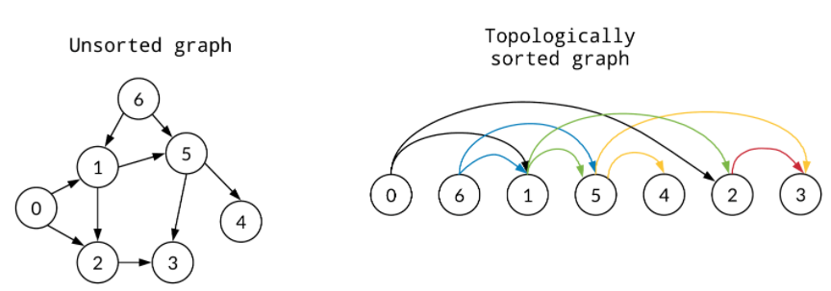
Topological Sort
In computer science, a topological sort or topological ordering of a directed graph is a linear ordering of its vertices such that for every directed edge from vertex u to vertex v, u comes before v in the ordering.
Topological sorting of only directed acyclic graph (DAG) is possible.

Slide 23
Topological Sort
There can be many topological sortings possible of given directed acyclic graph. Starting vertex should be the vertex where in degree is zero.
Applications :
Scheduling of jobs that are dependent on each other
Steps to follow while cooking , building houses etc
Pre-requisite course system like which course you need to study before understanding any particular course
and etc

Slide 24
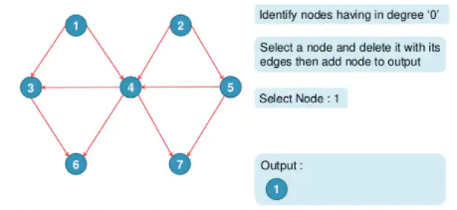
Topological Sort : Example

Slide 25
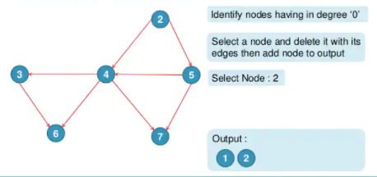
Topological Sort : Example

Slide 26
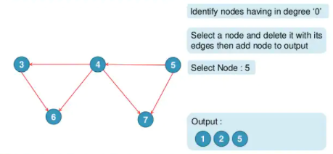
Topological Sort : Example

Slide 27
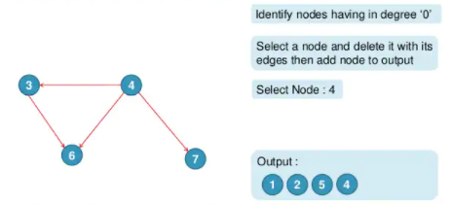
Topological Sort : Example

Slide 28
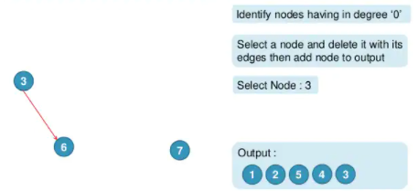
Topological Sort : Example

Slide 29
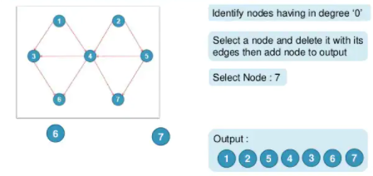
Topological Sort : Example

